Slide 1


Introduction to Time Series Analysis
Fondren Library
Digital Scholarship Services

Slide 2
WHAT ARE TIME SERIES?
Simply, data that are collected in a certain order
Evenly or unevenly spaced
Any number of variables

Slide 3
WHAT’S SO SPECIAL ABOUT TIME?
Many statistical models depend upon data points being independent
Linear Regression
Logistic Regression
Many more!
With time series, this basic assumption underlying the entire model can be wrong!
Disastrous results

Slide 4
WHY IS THIS IMPORTANT?
Time series are extremely useful for forecasting
Weather
Stocks (although this is very hard!)
Sports predictions
Election predictions
Well suited to a wide class of problems

Slide 5
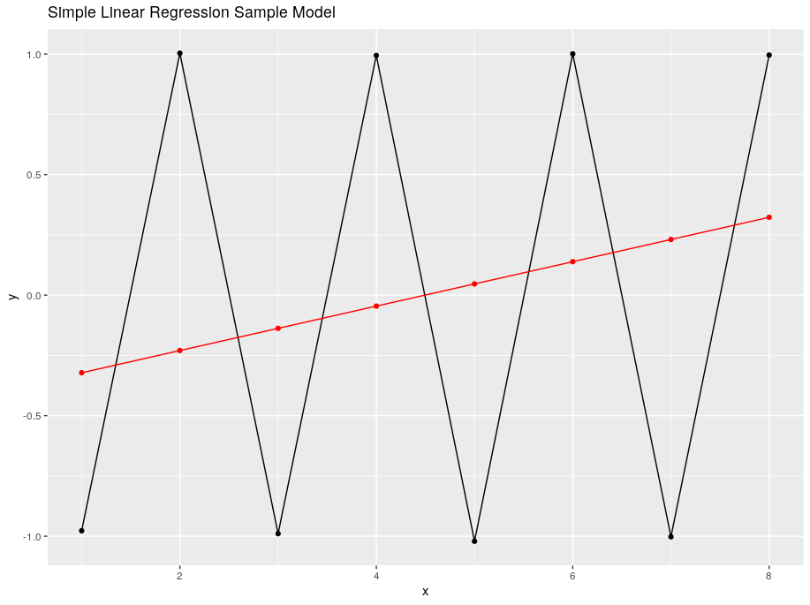
ONE QUICK EXAMPLE
Simple Linear Regression vs. a Time Series Model (ARIMA)

Slide 6
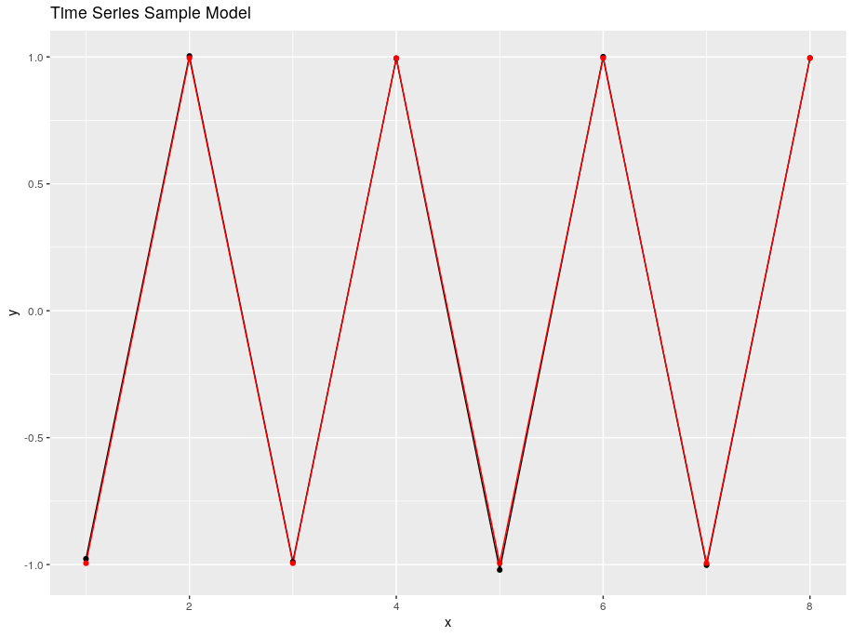
ONE QUICK EXAMPLE
Simple Linear Regression vs. a Time Series Model (ARIMA)

Slide 7
TRENDS AND SEASONALITY
How to filter out the noise and model what really matters

Slide 8
TRENDS

Slide 9
PERIODIC COMPONENTS

Slide 10
HOLIDAYS

Slide 11
WHITE NOISE

Slide 12
HOW TO MAKE YOUR DATA STATIONARY
Make your data appetizing for modeling

Slide 13
STATIONARITY

Slide 14
DETRENDING

Slide 15
LAGGING

Slide 16
LAGGED SCATTERPLOTS

Slide 17
ARIMA MODELS
Interpretable, simple and speedy time series modeling

Slide 18
ARIMA

Slide 19
AUTOREGRESSIVE

Slide 20
MOVING AVERAGE

Slide 21
PLAYING AROUND WITH ARIMA

Slide 22
ACKNOWLEDGMENTS

